Slide 1
Applications of Metagenomic
In Agriculture and Industry
Speaker: Ngo Dai Phu

Slide 2
Types of Metagenomics Experiments
Structural metagenomics (Presence, Abundance, Gene Annotation)
Targeted sequencing
16S/18S/ITS
Housekeeping genes (MLST)
Whole-metagenome sequencing (WMS) – Shotgun Sequencing
Functional metagenomics (Novel Biocatalyst, Metabolites and Microbe)
Whole genome shotgun
Enrichment culture
Single cell

Slide 3
Types of Metagenomics Experiments
Structural metagenomics (Presence, Abundance, Gene Annotation)
Targeted sequencing
16S/18S/ITS
Housekeeping genes (MLST)
Whole-metagenome sequencing (WMS) – Shotgun Sequencing
Functional metagenomics (Novel Biocatalyst, Metabolites and Microbe)
Whole genome shotgun
Enrichment culture
Single cell

Slide 4
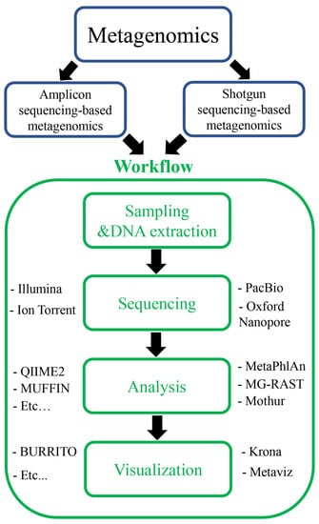
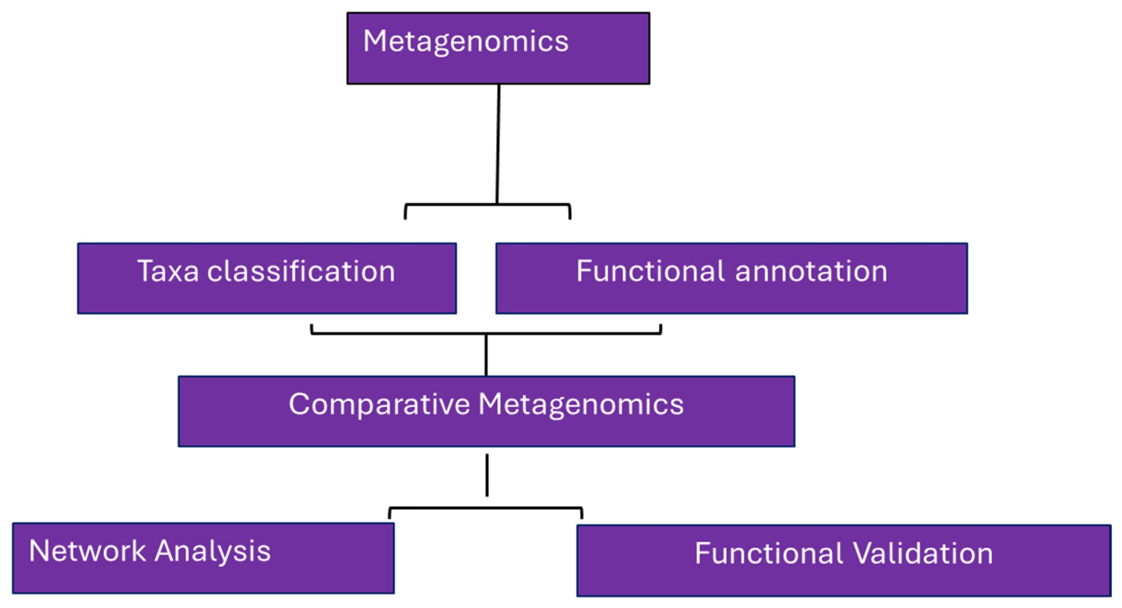
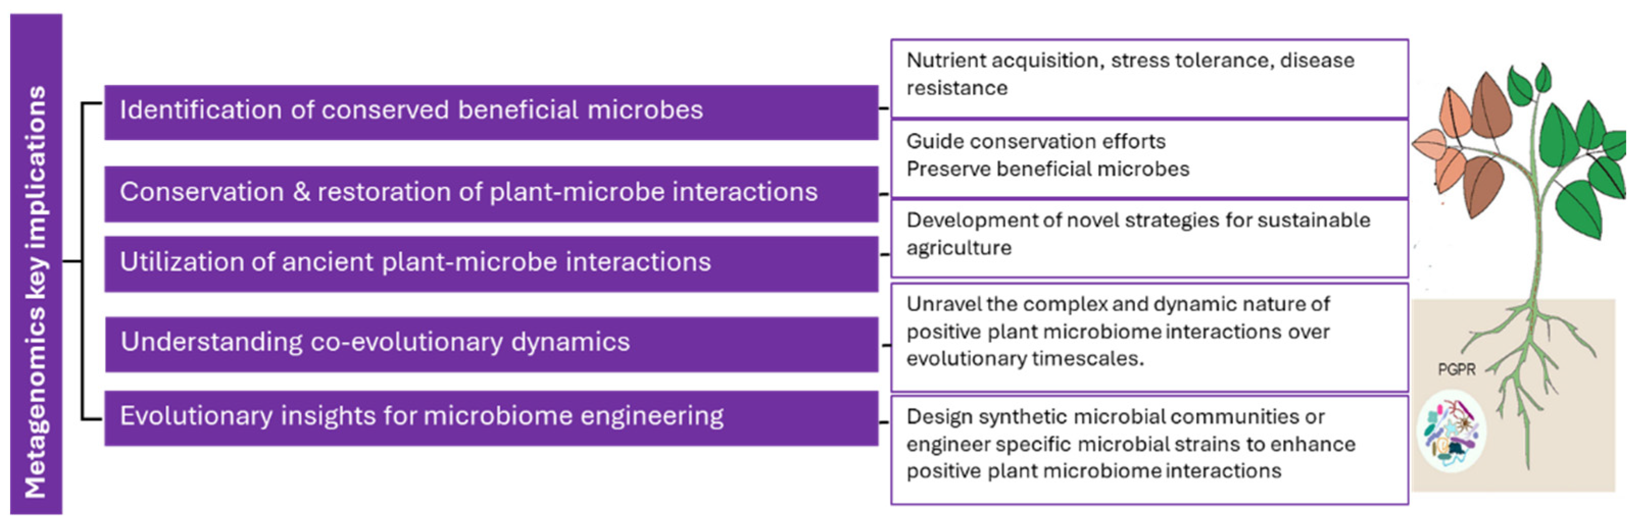
Structural metagenomics
https://doi.org/10.3390/microorganisms12030510
https://doi.org/10.3390/foods12112140
Notes:
https://www.mdpi.com/2304-8158/12/11/2140

Slide 5
Structural metagenomics Metagenomics studies in identifying candidate taxa and genes.
Taxa Classification | Gene Identification | Host | Reference
Ascomycota, Basidiomycota, Mortierellomycota, Actinobacteria, Alphaproteobacteria, Bacteriodota, Gammaproteobacteria | Plant pathogen interactions. 3-Indol Acetic Acid (IAA) pathways, tryptophan metabolism, aminobenzoyl-glutamate. ACC deaminase pathway. | Wheat rhizosphere | [96]
Actinobacteria, Chloroflexi, Cyanobacteria, Firmicutes, Bacteroidetes, Proteobacteria, Acidobacteria, Gemmatimonadetes, Nitrospirae, Planctomycetes, Tenericutes, TM7 | Iron metabolism. Ferritin1, Oxoglutarate/iron-dependent oxygenase Stabilizer of iron transporter SufD/Polynucleotidyl transferase. | Maize rhizosphere | [97]
Plant growth promoting taxa. Planctomycetes, Bacteroidetes, Verrucomicrobia, Cyanobacteria, Gemmatimonadetes, Chloroflexi, and Firmicute | Genes mitigating salt stress. Sulfur and glutathione metabolism bacterial chemotaxis, Sulfate reduction (cysNC, cysQ, sat, and sir), sulfur reduction (fsr), SOX systems (soxB), sulfur oxidation (sqr), organic sulfur transformation (tpa, mdh, gdh, and betC). | Grapevine rhizosphere | [98]
Streptomyces renae, Streptomyces flavovariabilis, Streptomyces variegatus, Streptomyces chartreusis and Streptomyces cellvibrio | Genes for metabolism of plant polysaccharides, iron, sulfur, trehalose, and vitamins, β-glucosidase Cellulose-hydrolyzing enzyme. | Tomato rhizosphere | [99]
Actinomycetia, Anaerolineae, Chloroflexia, and Nitrospira | Catalyzation of the transfer of oligosaccharides, dentification, nitrification, nitrate reduction genes, ureB, ureA, glnA, nxrB, amoA_A, amoC_A, amoB_B, norC, nirS, nirK, nirD, narJ, narH, napC nirA, narC nitrate reductase (Anr) and the gene pmoA. | Forest deep soil | [100]
Actinobacteria, Bacteroidetes, Firmicutes, and Proteobacteria | Carbohydrate metabolic processing, cell adhesion, pathogenesis, response to abiotic stimulus, and responses to chemicals. | Barley Rhizosphere | [101]
Pseudomonas, Agrobacterium, Cupriavidus, Bradyrhizobium, Rhizobium, Mesorhizobium, Burkholderia, Cellvibrio, Sphingomonas, Variovorax and Paraburkholderia | Plant-microbe and microbe-microbe interactions, nutrition acquisition, and plant growth promotion genes, pqqB, appA, phnCEF, nrtABC, phoRPA, senX3, regX3, pmoA/amoA, ics, irp9, nagG, nagH, udC, nirK. | Citrus rhizosphere | [102]
Rhizophagus, Burkholderia, Trichoderma, Fusarium, Ochrobactrum phage POA1180, Blastococcus, Microvirga, Nocardioides, Geodermatophilus, Belnapia, Solirubrobacter, Arthrobacter, Mycobacterium phage Edugator, and Mycobacterium phage Kratio | Not identified. | Cleome pallida (Desert plant) rhizosphere | [103]
Kaistobacter and Rubrobacter Bacillus Nocardioides, Cellulomonas, Skermanella, Methylobacterium, Modestobacter and Aeromicrobium, Rhizobiales, Kaistobacter, Rubrobacter or Bacillus | Metabolism of carbohydrate (especially C degradation) and membrane transporters. Carbohydrate degradation metabolism, carbohydrate synthesis, and its related energy metabolism. | Chickpea, wheat | [104]
https://doi.org/10.3390/microorganisms12030510

Slide 6
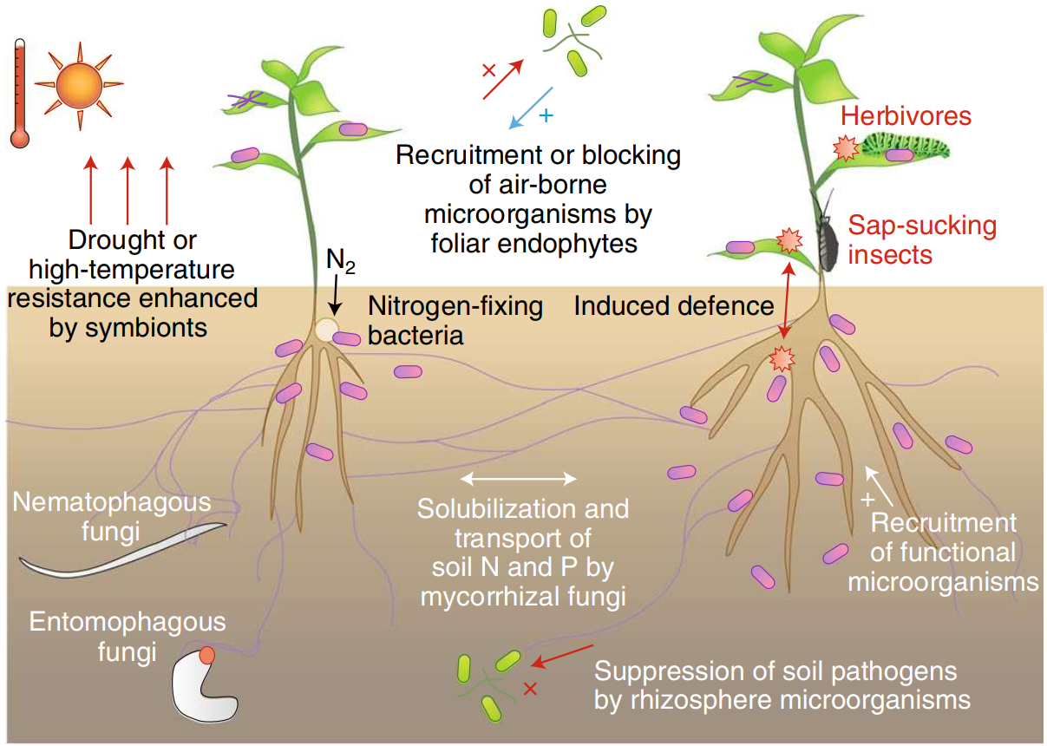
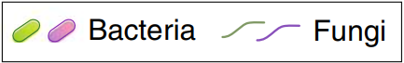
A Specific Example of Structural Metagenomics
Entangled webs of below-ground interactions. In ecosystems, plants not only face biotic/abiotic environmental stresses but also interact with microorganisms with various functions. Nitrogen-fixing bacteria and mycorrhizal fungi, for example, supply solubilized nitrogen (N) and/or phosphorus (P) to host plants, thereby allowing us to reduce chemical fertilizer input into agroecosystems. Some of those symbionts are also known to enhance host plants’ resistance to drought and salinity stress. Phyllosphere endophytes, disease-suppressive bacteria and nematophagous/entomophagous fungi may play essential, but often overlooked, roles in suppressing populations of air-borne or soil-borne pathogens and pests. Untapped sources of microbial functions will be explored not only in agroecosystems, but also in natural ecosystems.
https://doi.org/10.1038/s41477-018-0139-4

Slide 7
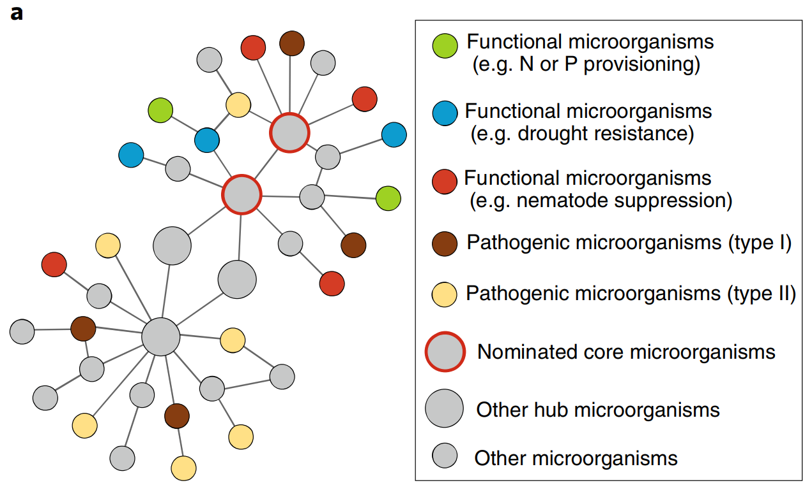
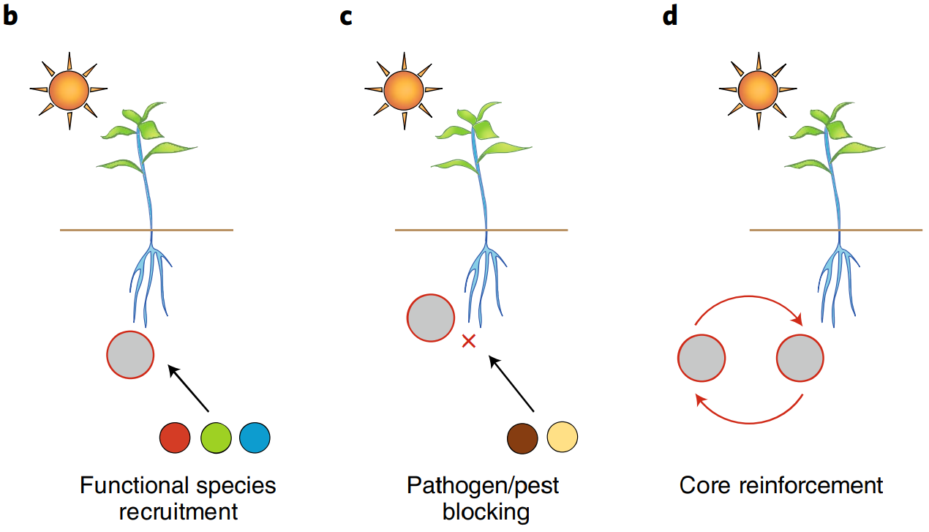
A Specific Example of Structural Metagenomics
Managing native biomes using core microorganisms. a, Nominating core microorganisms. Within a microbial network, hub microbial species or strains are defined solely based on network topology data. Among those topological hubs, it is possible to explore candidates of core microorganisms that are expected to mediate interactions between plants and native microbiomes. b–d, In our definition (Box 1), core microorganisms are scored based on their potential for recruiting native microorganisms with diverse physiological and ecosystem functions (b) and potential for blocking pathogen/pest infection (c). Such roles of core microorganisms will be further reinforced by introducing pairs or sets of core microorganisms in facilitative interactions (that is, core microbiomes) (d).
https://doi.org/10.1038/s41477-018-0139-4

Slide 8
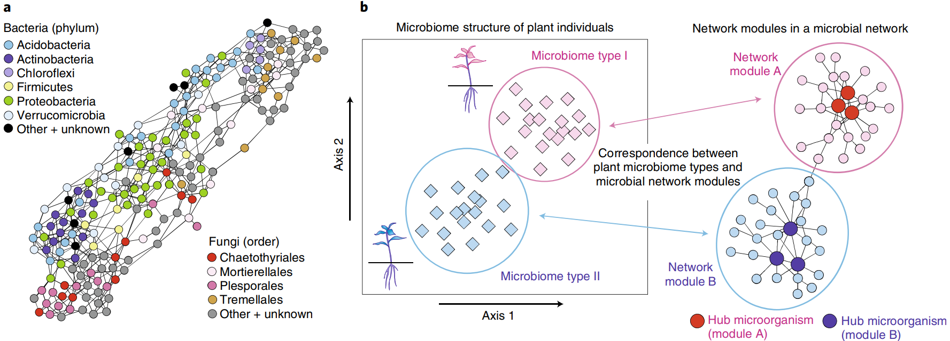
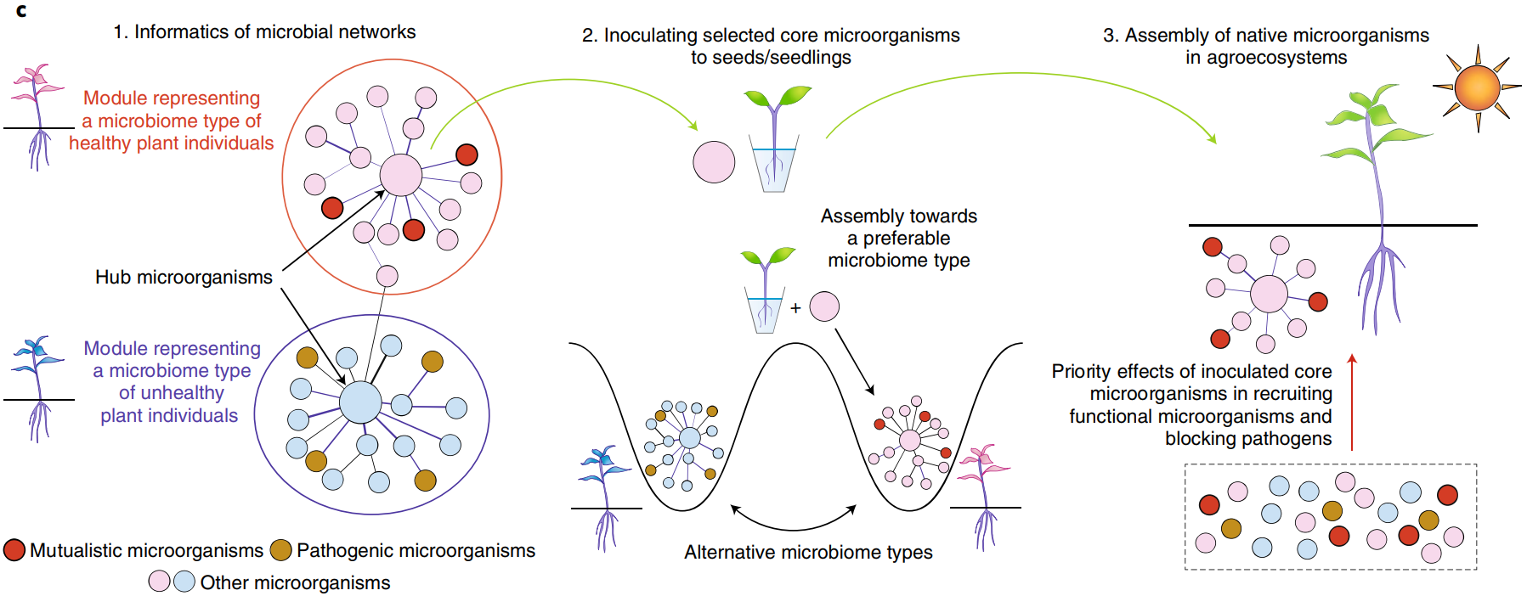
Microbial network information for controlling microbiomes in agroecosystems. a, Network depicting potential inter-microorganism associations. Microorganisms frequently co-occurring in the soil are connected. Those that are interlinked can share environmental preferences and/or interact with each other in complementary or facilitative ways. Only the top-100 bacteria and top-100 fungi that were most abundant in the soil samples collected along an environmental gradient in Hawaii86 are shown. b, Microbial network modules and plant microbiome types. Microbial networks often contain modules, which represent groups of frequently coexisting microorganisms. Microbial network modules may represent or be represented by microbiome types of plant individuals. c, Controlling native microorganisms with inoculated core microorganisms. For the first step, modules representing microbiome types of healthy plant individuals are searched within network data (1). Some hub microorganisms of the selected modules are then inoculated to seeds or seedling as candidates of core microorganisms (2). When the inoculated plants are introduced to agroecosystems, those that can coexist with the embedded core microorganisms will be preferentially recruited from the pool of indigenous microorganisms (3)
https://doi.org/10.1038/s41477-018-0139-4

Slide 9
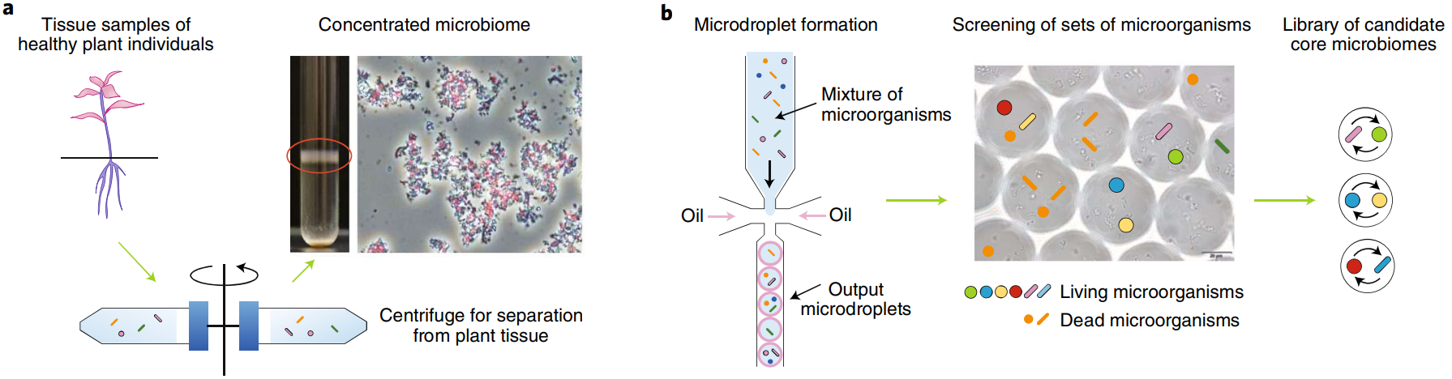
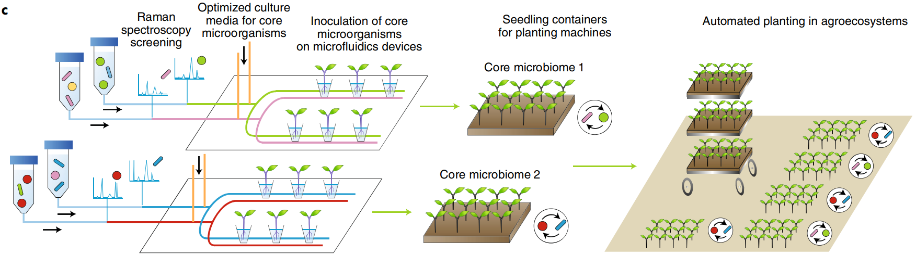
Preparing and deploying core microbiomes. a, Microbiome cocktails. Symbiont cells obtained from healthy plant individuals can be enriched by centrifuge-based methods92,93. b, Application of microdroplet technologies for isolating and screening core microbiomes. Microdroplet devices, which were originally developed for the isolation of single cells94, will be used for screening pairs/sets of core microorganisms interacting with each other in facilitative ways (that is, core microbiomes). c, Deploying core microbiomes. Single-cell phenotyping/screening based on Raman spectroscopy95 and microfluidics devices90,96,97 can be used for high-throughput inoculation of sets of core microorganisms into seedlings. The use of multiple core microbiomes will increase heterogeneity within agroecosystems, contributing to the recruitment of diverse functional microorganisms and the prevention of pathogen/pest outbreaks.
https://doi.org/10.1038/s41477-018-0139-4

Slide 10
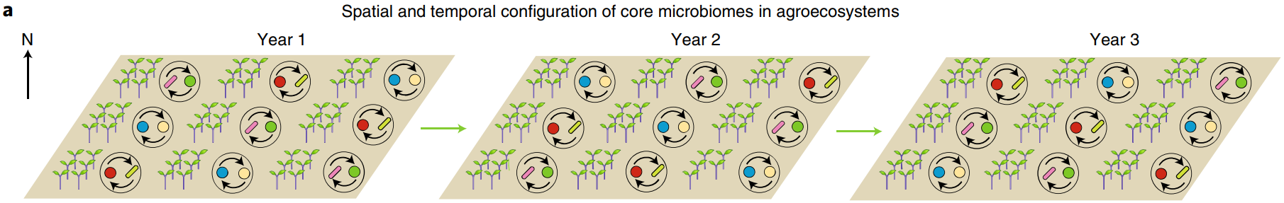
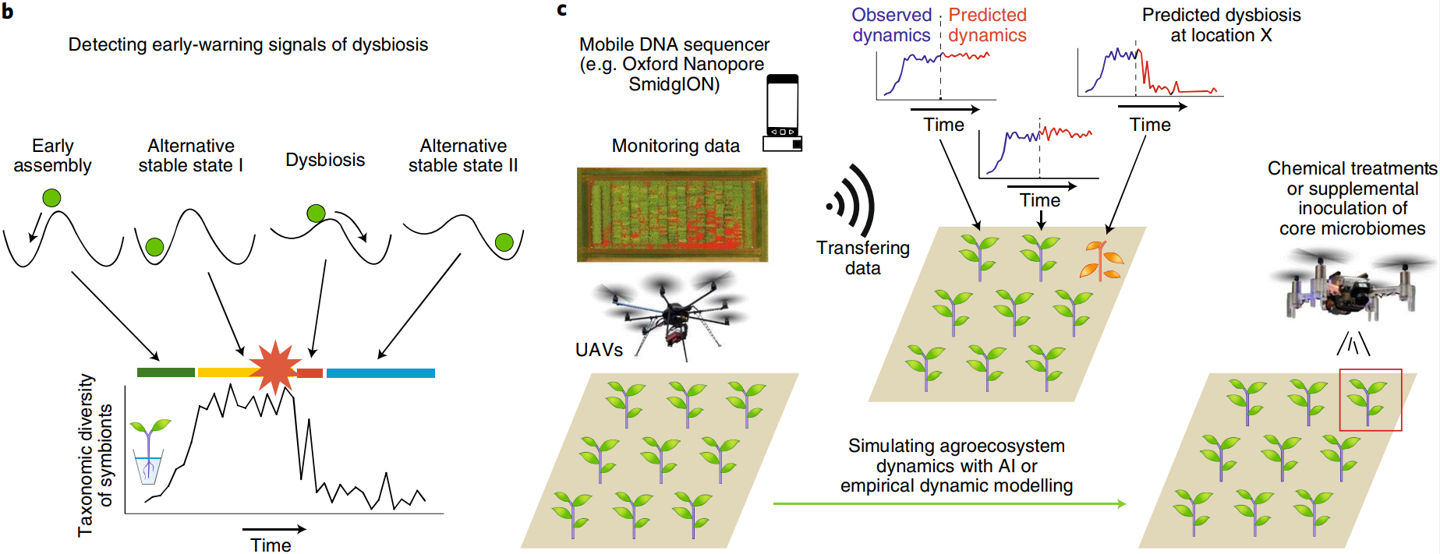
Agroecosystem management. a, Spatiotemporal configurations of core microbiomes. Theoretical studies for optimizing spatial and temporal configurations of core microbiomes may help us prevent the spread and evolution of pathogens in agroecosystems. b, Predicting dysbiosis. The taxonomic diversity of plant-associated microorganisms will increase and reach a plateau during initial assembly, while it can drop in dysbiosis events having deleterious effects on hosts. Time-series analytical methods such as empirical dynamic modelling73,78 may allow us to forecast future dysbiosis. c, Forecasting microbiome dynamics in agroecosystems. Unmanned aerial vehicles (UAVs) and mobile DNA sequencers enable automated monitoring of plant physiology and microbiome structure, providing a basis for simulating agroecosystem dynamics. Regions indicated in red in the UAV image of farmland indicate the potato plants damaged by Phytophthora oomycetes112. Such monitoring and informatics platforms will help in exploring the best timing for introducing crop plants inoculated with core microbiomes. When dysbiosis is forecasted in such smart-farming systems, chemical treatments or other types of operations at specific timing and locations may be feasible with fleet management of (multiple) micro-UAVs.
https://doi.org/10.1038/s41477-018-0139-4

Slide 11
Types of Metagenomics Experiments
Structural metagenomics (Presence, Abundance, Gene Annotation)
Targeted sequencing
16S/18S/ITS
Housekeeping genes (MLST)
Whole-metagenome sequencing (WMS) – Shotgun Sequencing
Functional genes
Functional metagenomics (Novel Biocatalyst, Metabolites and Microbe)
Whole genome shotgun
Enrichment culture
Single cell

Slide 12
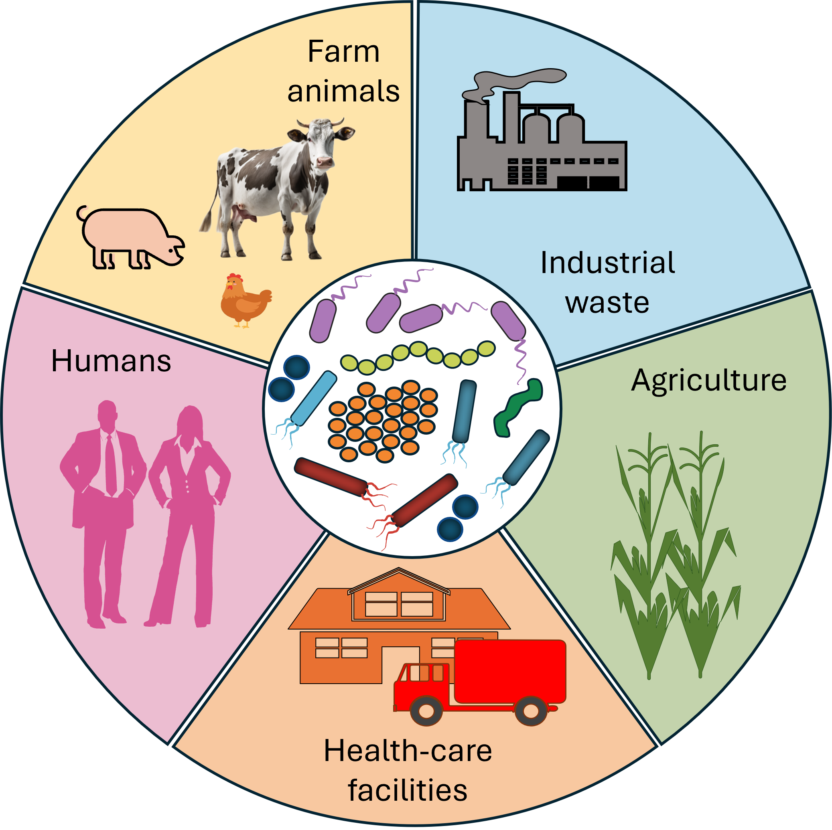
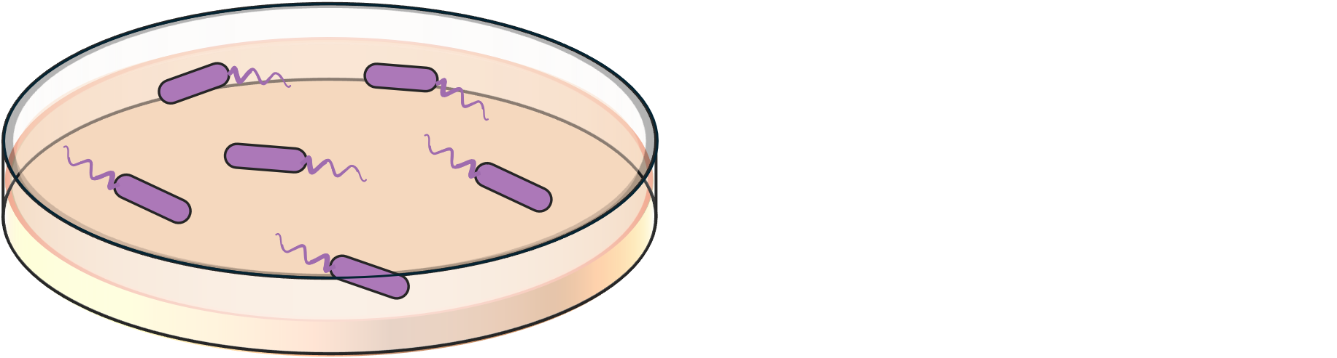

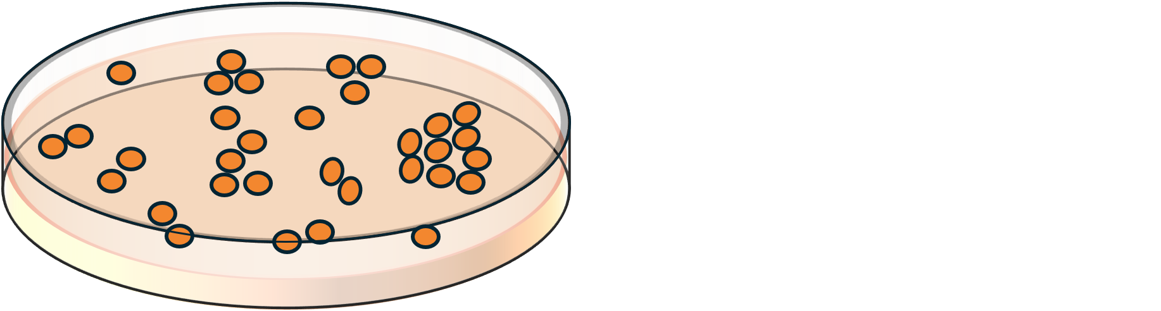
Method 1: Functional metagenomics
Culture-dependent method (isolate genomics)
DNA
extraction
Library
preparation
DNA
sequencing
Quality
filtering
Pure culture
in selective
media
Raw reads
Preprocessed Clean reads
Genomic DNA
Sequencer
It is estimated that only about 1% of microbial species can be successfully cultured in a laboratory setting using traditional methods. The vast majority of microbial diversity, approximately 99%, remains uncultured or "unculturable" using standard techniques.
https://doi.org/10.1038/s41576-019-0108-4 https://doi.org/10.1111/j.1574-6968.2010.02000.x

Slide 13
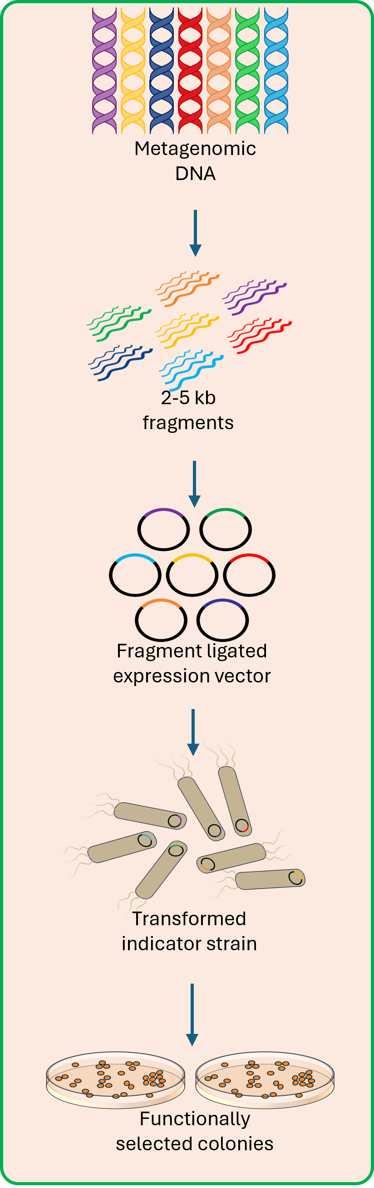
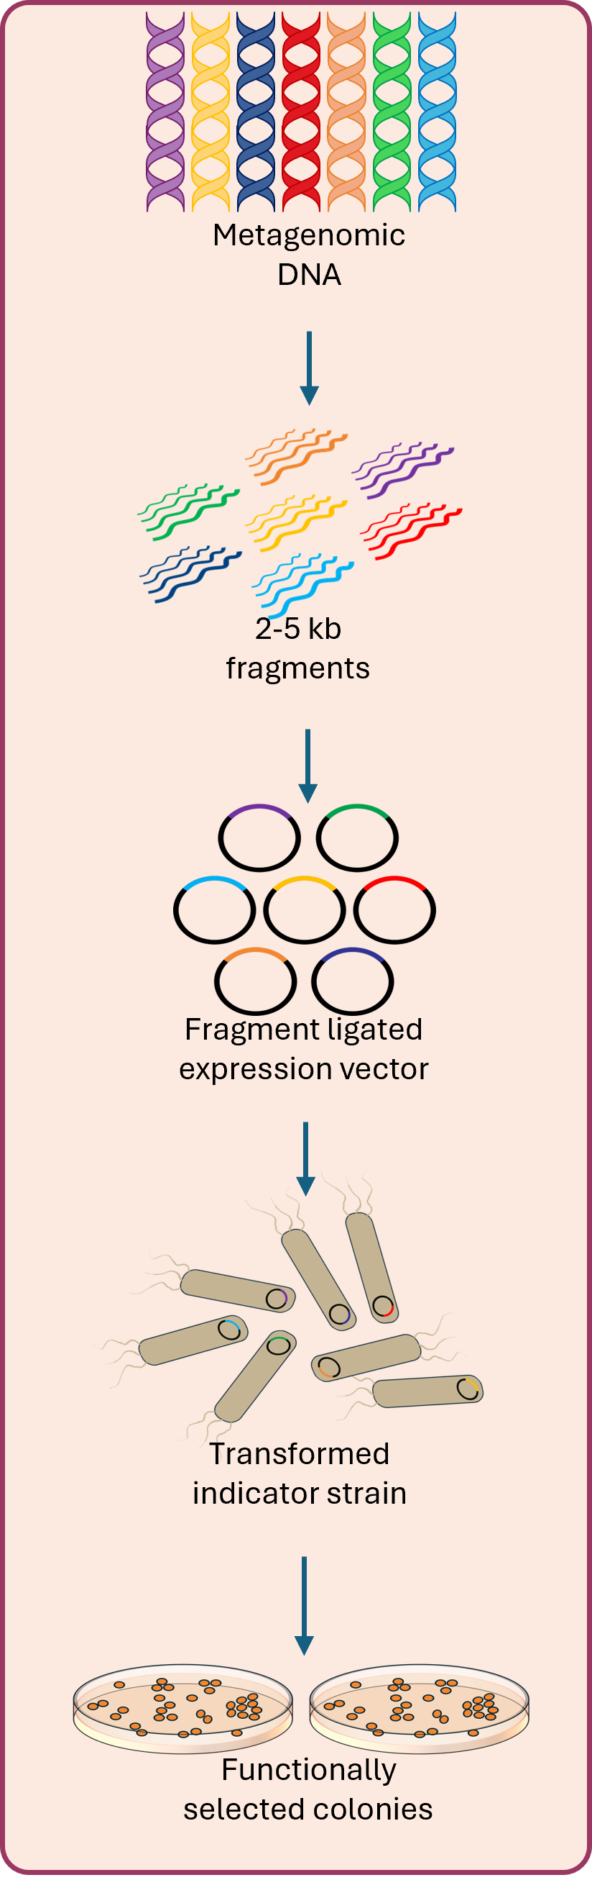








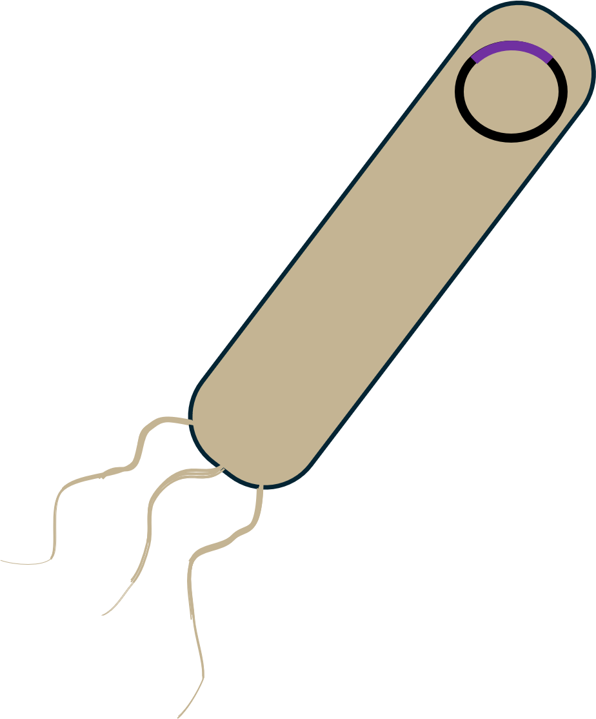

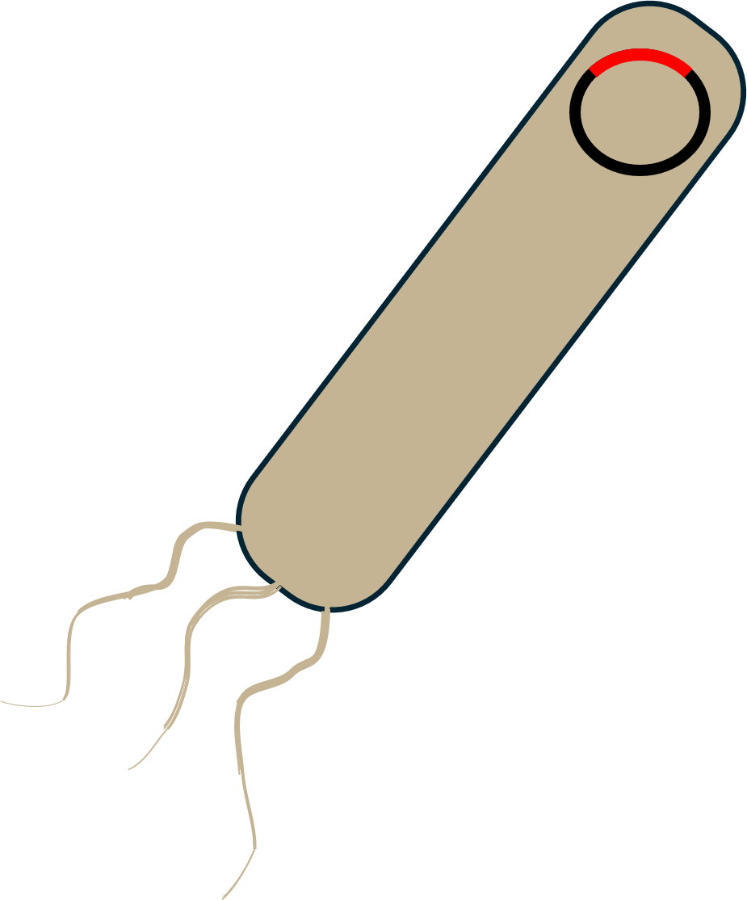
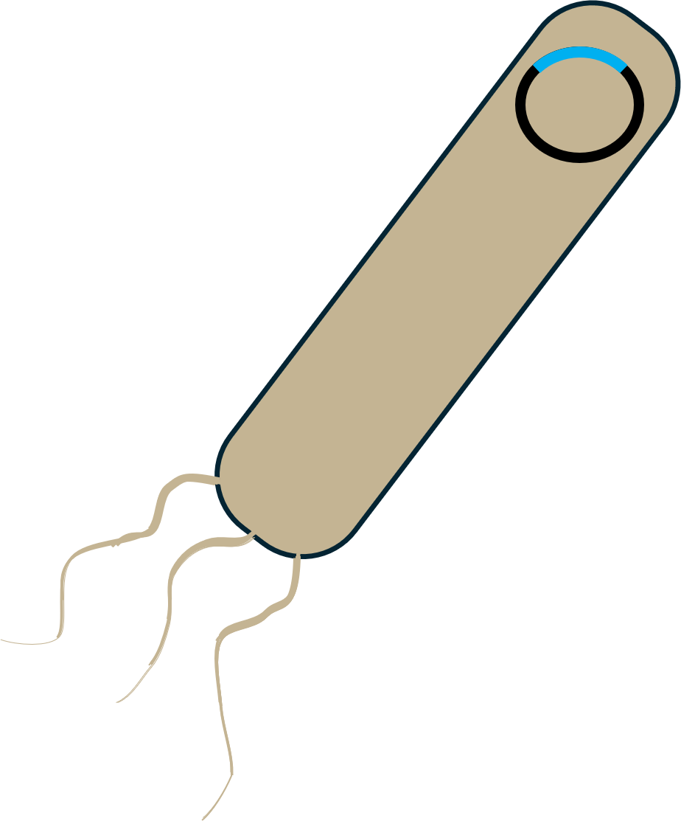
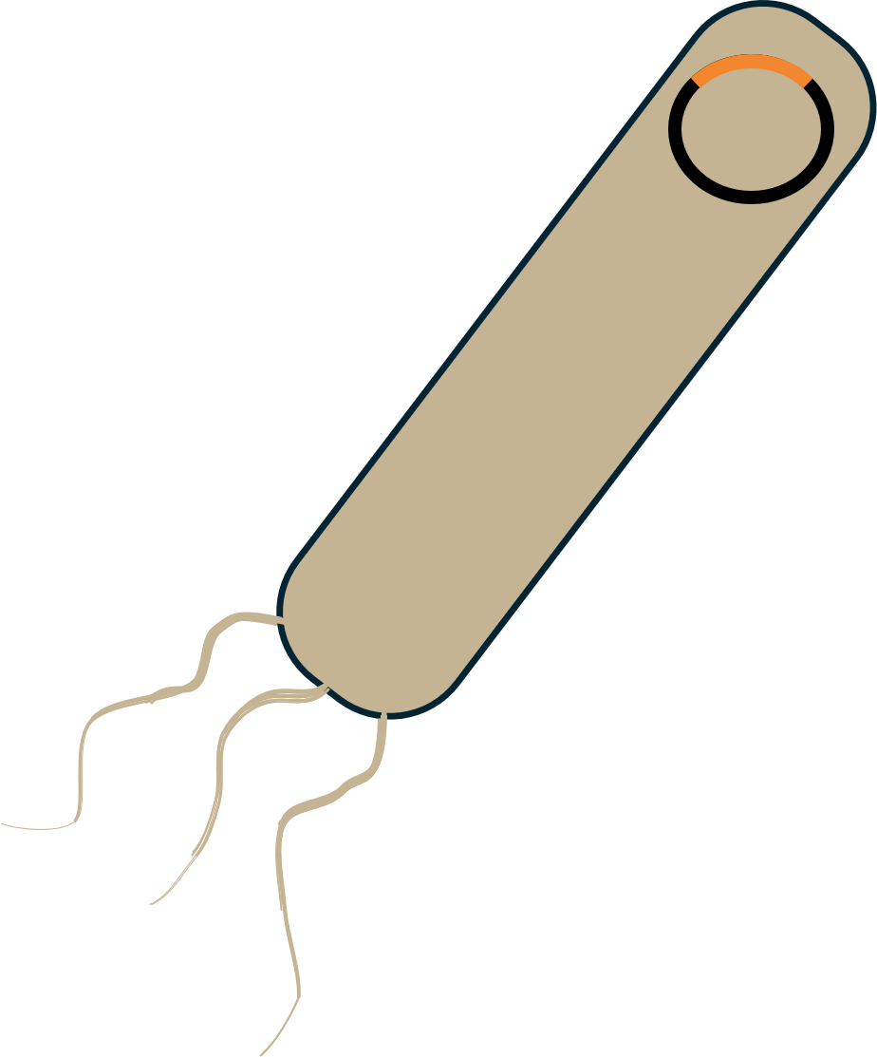

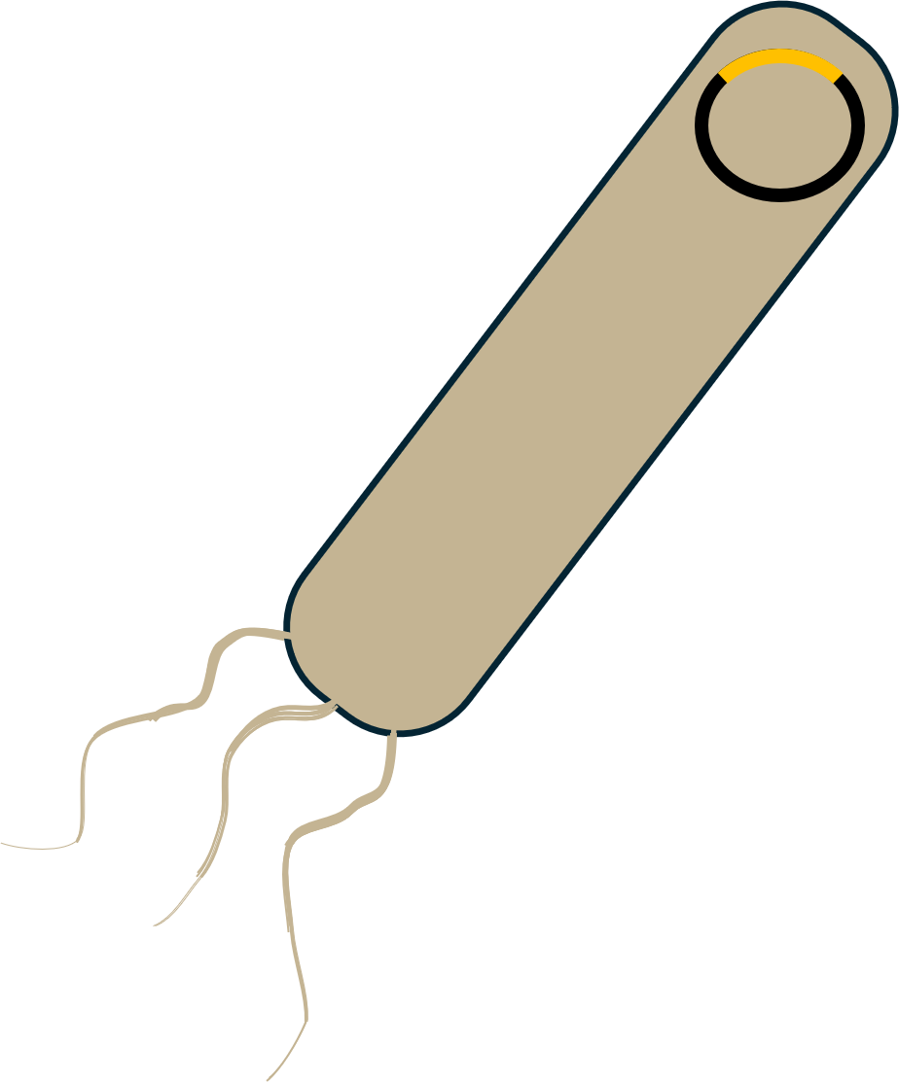
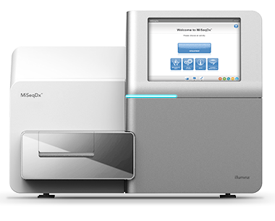
Method 2:
Functional
Metagenomics
Gens Annotation
DNA extraction from source
Metagenomic DNA
BLAST or HMM
Database
Final contigs
2-5 kb fragments
Long-read Assembly
Assembly (x2)
Filtered contigs
Assembled contigs
Final contigs
Fragment ligated expression vector
Unassembled contigs
Short-read Assembly
Assembly (x3)
Clean reads
Assembled contigs
Filtered contigs
Transformed indicator strain
Unassembled contigs
Samples collection
Functional selection
Functionally selected colonies
Library preparation and sequencing
Sample 1
Sample n
Sample 2 . . .
Sample 1
Sample 2
. . .
Sample n
Iterative assembly
Pooled selected fragments
Demultiplexing
Annotation
Library preparation
Barcoded selected fragments
https://doi.org/10.1038/s41576-019-0108-4
Sequencing

Slide 14

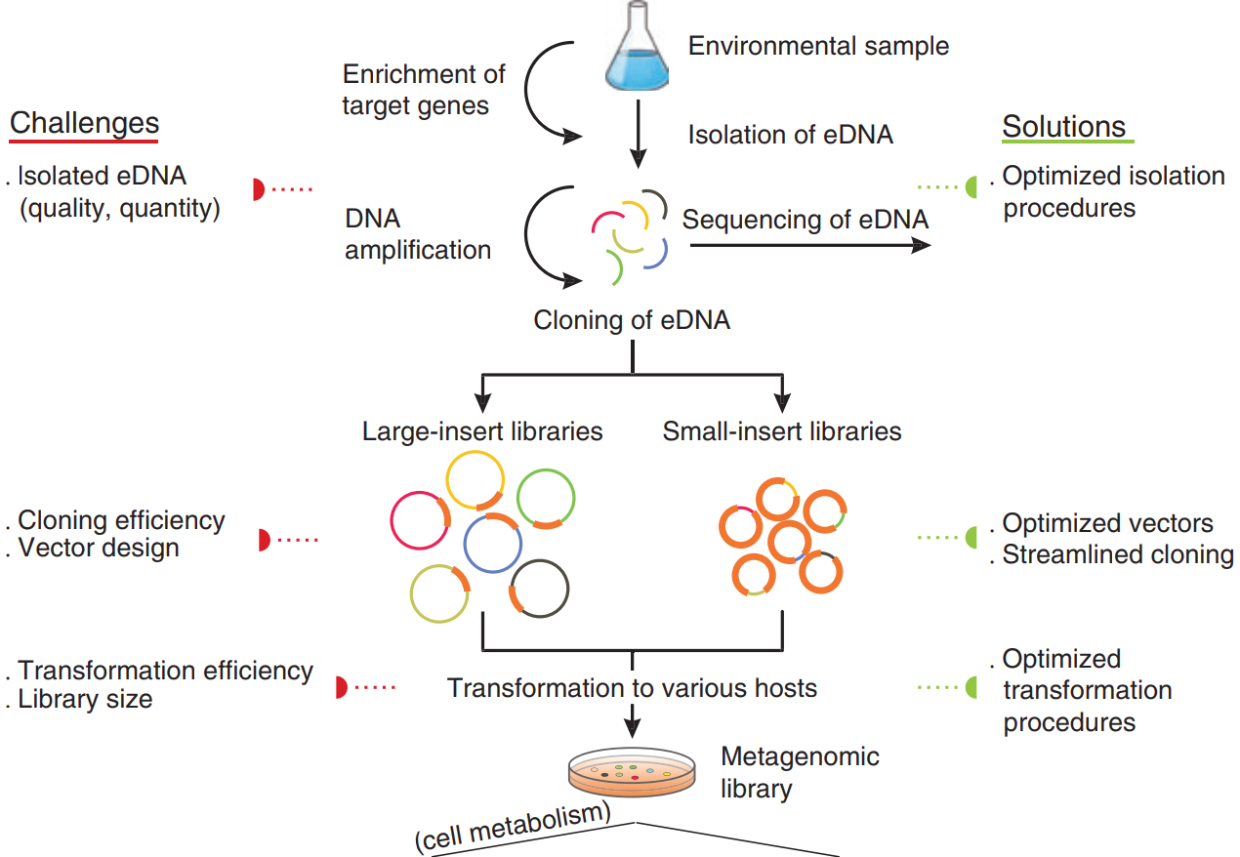
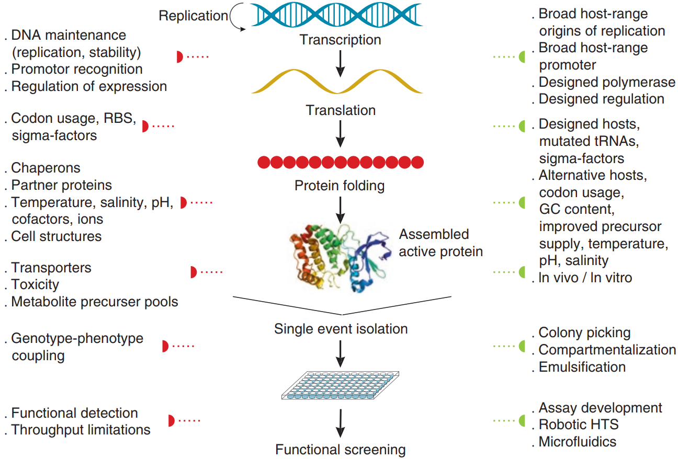
Method 2:
Functional
Metagenomics
https://doi.org/10.1007/978-3-319-61510-3_2

Slide 15
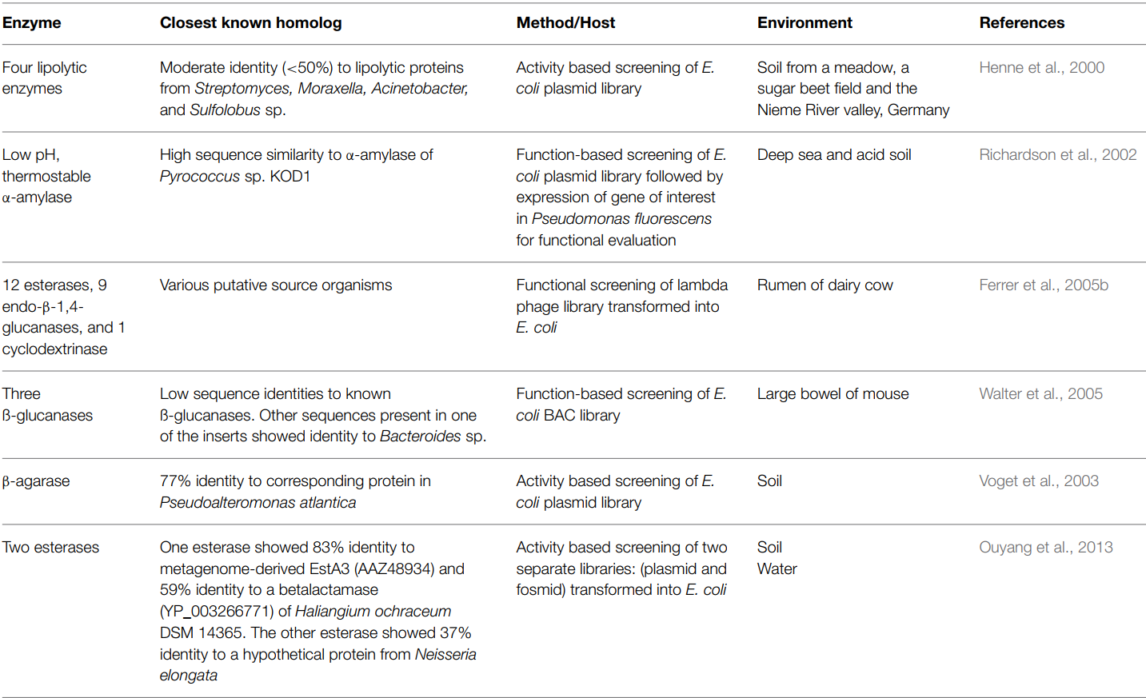
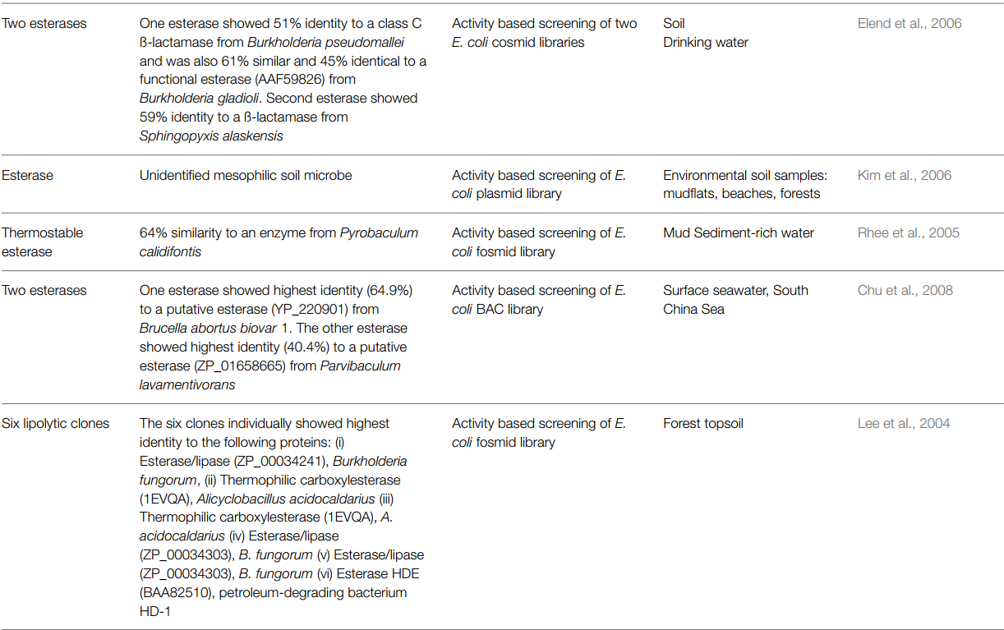
Functional
Metagenomics
Some novel enzymes of industrial interest discovered through functional metagenomics.
doi: 10.3389/fmicb.2015.00672

Slide 16
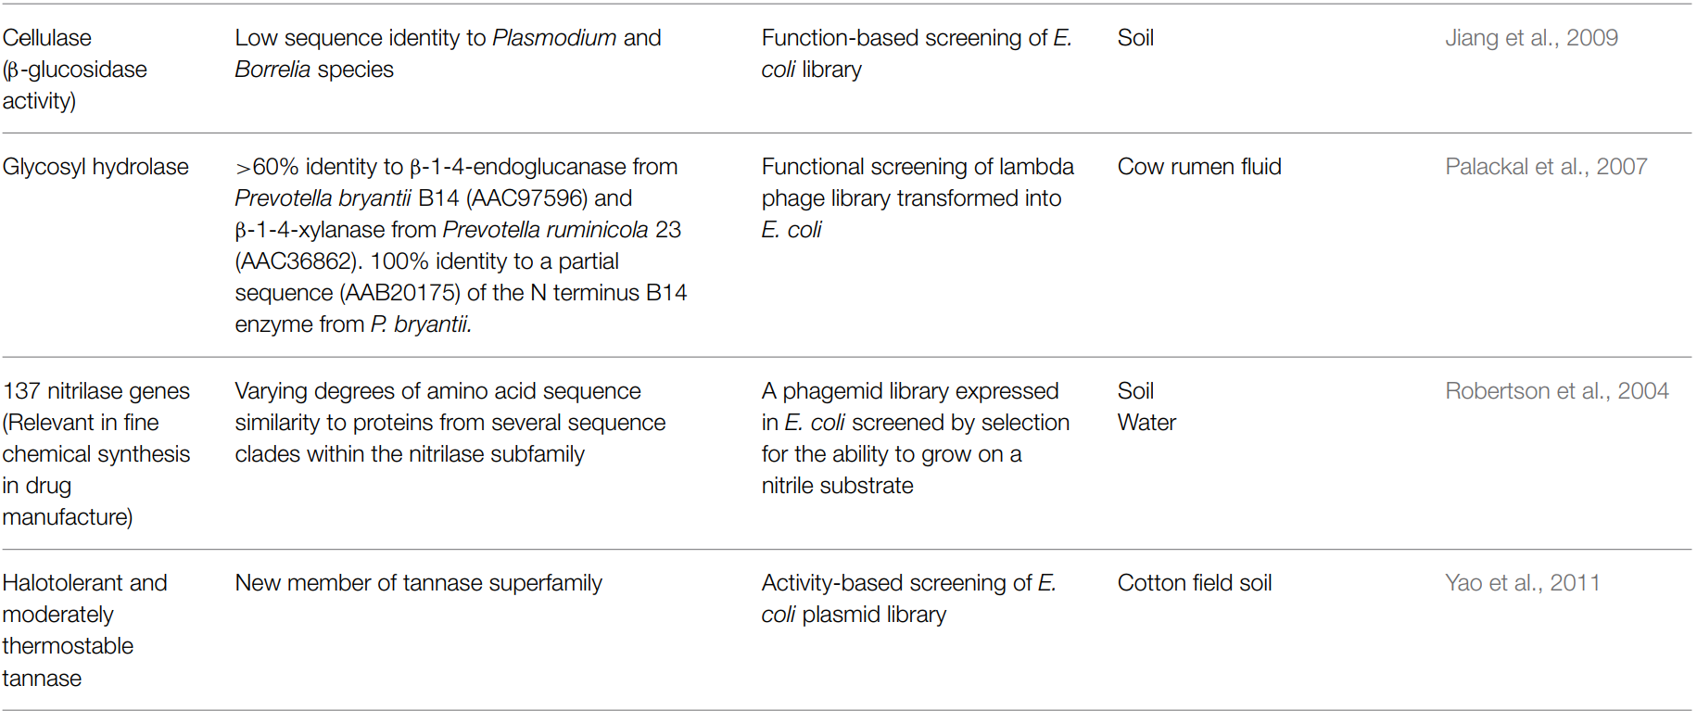
Functional
Metagenomics
Some novel enzymes of industrial interest discovered through functional metagenomics.
doi: 10.3389/fmicb.2015.00672

Slide 17
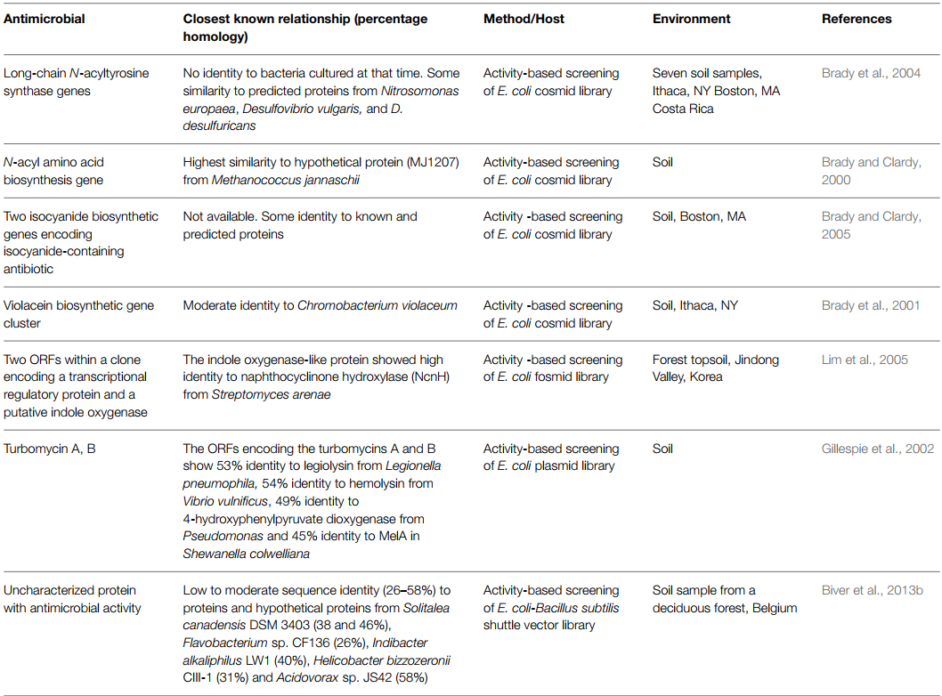
Functional
Metagenomics
Some novel antimicrobials, anti-infectives and antimicrobial resistance genes discovered through functional metagenomics.
doi: 10.3389/fmicb.2015.00672

Slide 18
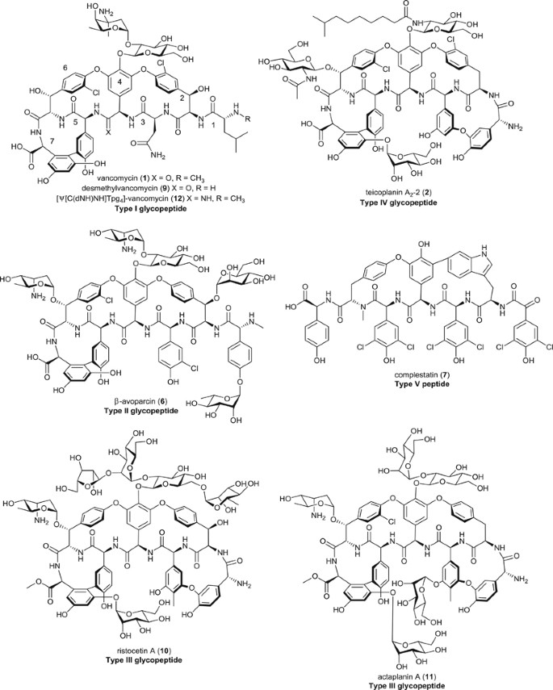
A Specific Example for Functional Metagenomics
Glycopeptide antibiotic, Vancomycin
Briefly, the project had its origins in a friendship between a Reverend William Conley and Dr. E. C. Kornfield who first met in 1944 when the US 82nd Airborne Division parachuted into Sicily. Kornfield went on to work as an organic chemist at Eli Lilly, while Conley became a missionary in Borneo. The two exchanged letters, and Kornfield, looking for novel sources of biodiversity in the hunt for new antibiotics for Eli Lilly, sent sterile vials to Conley requesting he return soil samples ‘collected off the beaten track’. An actinomycete, Streptomyces orientalis (now called Amycolatopsis orientalis),⁴² was isolated from the soil sample delivered to Eli Lilly in 1953, and Kornfield demonstrated it could produce a new antibiotic.
https://doi.org/10.1038/ja.2014.111
Notes:
https://en.wikipedia.org/wiki/Glycopeptide_antibiotic
https://www.nature.com/articles/ja2014111

Slide 19
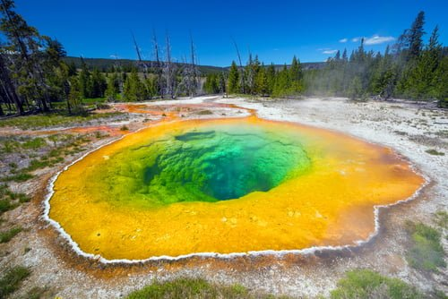
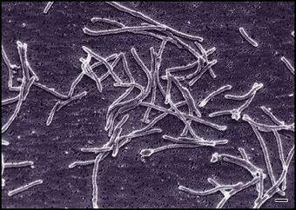
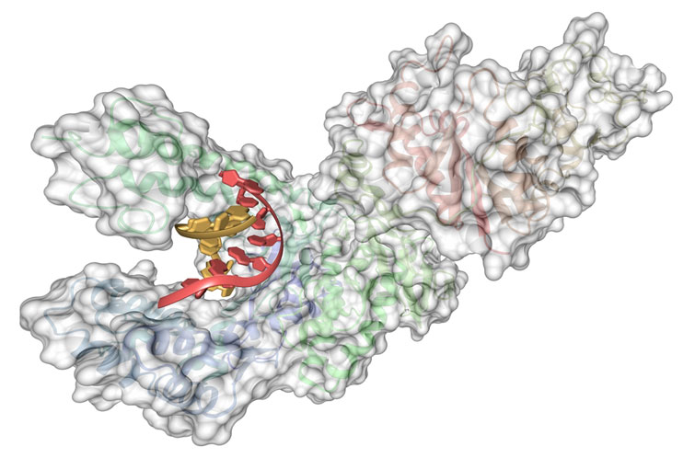
A Specific Example for Industry
Tag DNA polymerase
Bacterium Thermus aquaticus

Slide 20
Structural metagenomics
Targeted sequencing
Whole-metagenome sequencing
Functional metagenomics
Whole genome shotgun
Enrichment culture
Single cell

Slide 21
Thank You!

